Slide 1

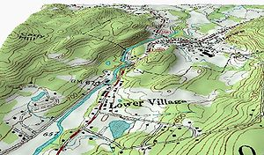

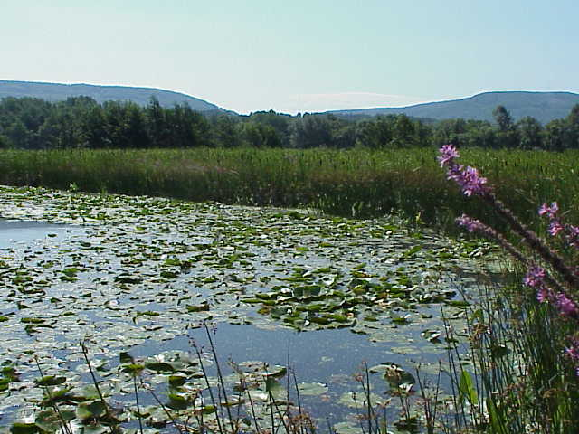

Navigable Waters Protection Rule -
Tinkering At the Baseline
Austin American Society of Civil Engineers
Virtual Meeting
April 20, 2021
Chandler Peter
Technical Specialist
Regulatory Division
Fort Worth District
US Army Corps of Engineers
BUILDING STRONG®

Slide 2
Normal Steps of Permit Process
Determine if water of the US involved w/ project
Determine if regulated discharge is involved
Determine if activity w/ regulated discharge is exempt
Determine what kind of permit (NWP, GP, IP) is applicable to project
Commence permit process
Notes:
Now spending much more time at step 1 before getting into the permitting process. Expect greater delays. Many nuances to consider and apply to determine class/status of water features. Types of JDs needs to be considered and decided. Utilization of more tools for delineation and classification can occur taking more time to determine if water features are WOTUS.

Slide 3
Waters of the US
Rules, Rules & More Rules
Former Rule - 1986 regulations w/ 2000s Rapanos guidance
Clean Water Rule - 2015 Obama Rule – repealed 2019.
“Step 1 rule (see #1 above w/ minor modifications) – 2019 - 2020
Navigable Waters Protection Rule (NWPR) - 2018 Trump Rule – signed 1/2020 – effective 6/22/2020
    Currently being challenged by numerous states, Tribes and non-governmental organizations but in effect.
  Goal - streamline & easily apply

Slide 4
NWPR - Waters of the U.S.
33 CFR 328.3
  (a) Jurisdictional waters.
(1) The territorial seas, and waters which are currently used, or were used in the past, or may be susceptible to use in interstate or foreign commerce, including waters which are subject to the ebb & flow of tide;
(2) Tributaries;
(3) Lakes and ponds as well as impoundments of jurisdictional waters; and
(4) Adjacent wetlands.
Notes:
(a)(1) and (a)(3) waters are simplest to ID. There are 10 (a)(1)s are designated in SWF. A lot more time needed for (a)(2) and (a)(4) when non-abutting

Slide 5
NWPR – Non-Waters of the U.S.
33 CFR 328.3
  (b) Non-jurisdictional waters.
(1) Waters or water features that are not identified in paragraphs (a)(1) through (4) of this section;
(2) Groundwater, including groundwater drained through subsurface drainage systems;
(3) Ephemeral features, including ephemeral streams, swales, gullies, rills, and pools;
(4) Diffuse stormwater run-off and directional sheet flow over upland;
Notes:
The B1 exclusion has already resulted in agencies having to administratively create subclasses. These non-JD features are taking most of the effort and time to document and determine status.

Slide 6
NWPR – Non-Waters of the U.S.
(5) Ditches that are not paragraph (a)(1) or (2) waters, & those portions of ditches constructed in paragraph (a)(4) waters that do not satisfy conditions of para. (c)(1) Adjacent Wetlands;
(6) Prior converted cropland;
(7) Artificially irrigated areas, including fields flooded for agricultural production, that would revert to upland should application of irrigation water to that area cease;
(8) Artificial lakes and ponds, including water storage reservoirs and farm, irrigation, stock watering, and log cleaning ponds, constructed or excavated in upland or in non-jurisdictional waters, so long as those artificial lakes and ponds are not impoundments of jurisdictional waters that meet conditions of paragraph (c)(6) Lakes, Pond & Impoundments;

Slide 7
NWPR – Non-Waters of the U.S.
(9) Water-filled depressions constructed or excavated in upland or in non-jurisdictional waters incidental to mining or construction activity, and pits excavated in upland or in non-jurisdictional waters for the purpose of obtaining fill, sand, or gravel;
(10) Stormwater control features constructed or excavated in upland or in non-jurisdictional waters to convey, treat, infiltrate, or store stormwater run-off;
(11) Groundwater recharge, water reuse, and wastewater recycling structures, including detention, retention, and infiltration basins and ponds, constructed or excavated in upland or in non-jurisdictional waters; and
(12) Waste treatment systems.

Slide 8
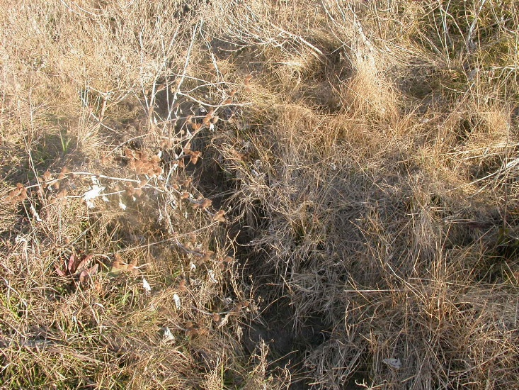
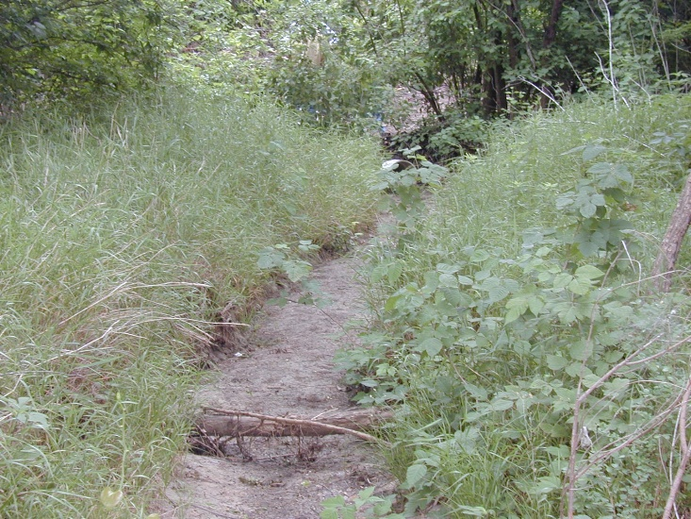
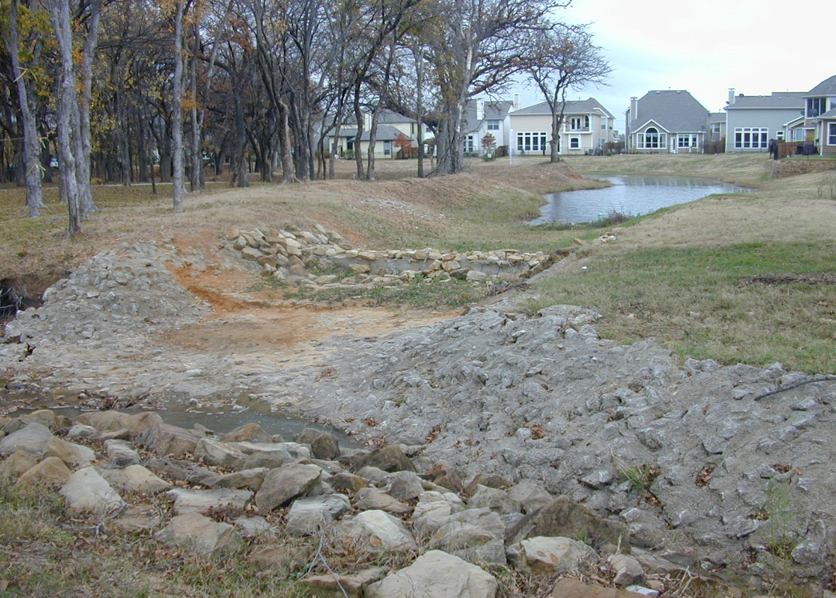
No longer waters
Notes:
Lower left photo was sig. nexus test area. Now is type of area that will require more effort to make determination of JD or not – especially for upstream areas

Slide 9
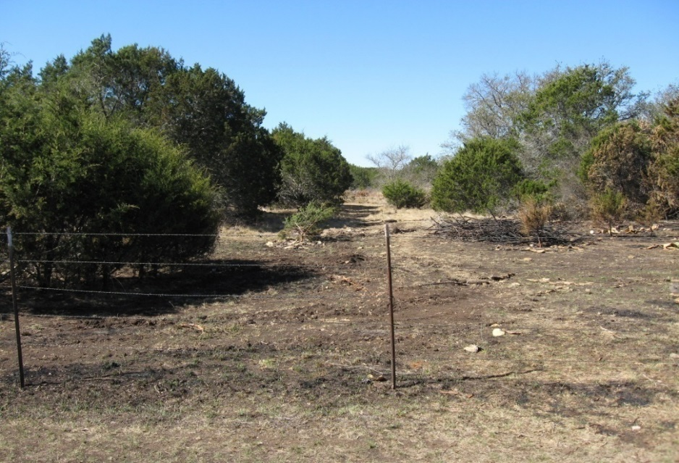
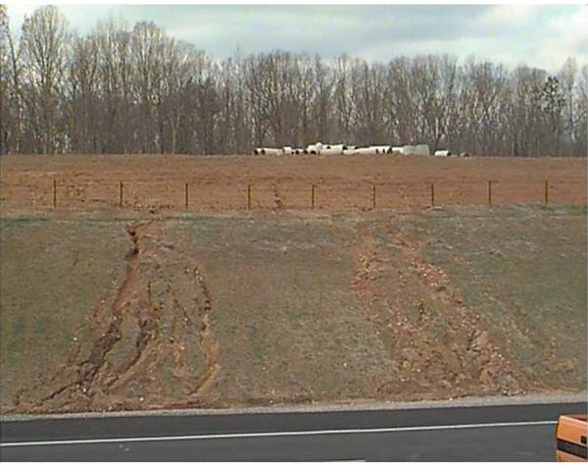
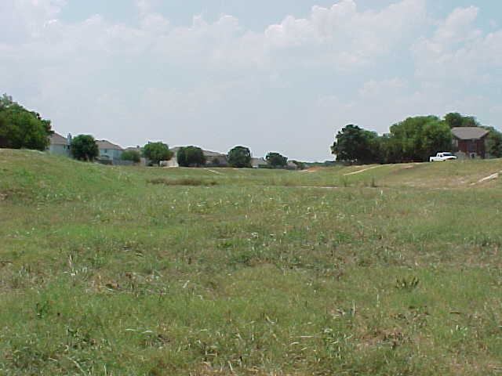
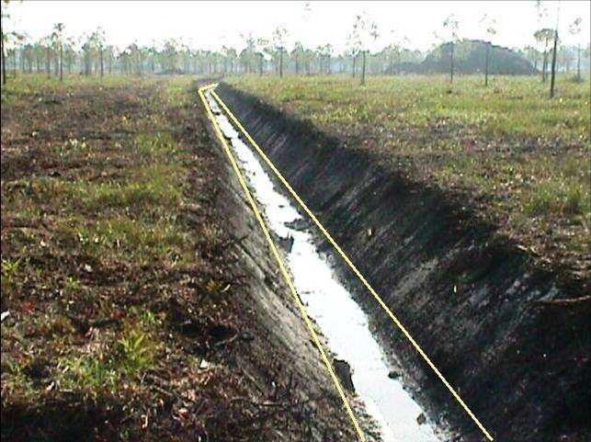
Not waters (never were)
Notes:
Swales (2 left photos) rills and certain ditches all must be addressed in delineation if an AJD is involved.

Slide 10
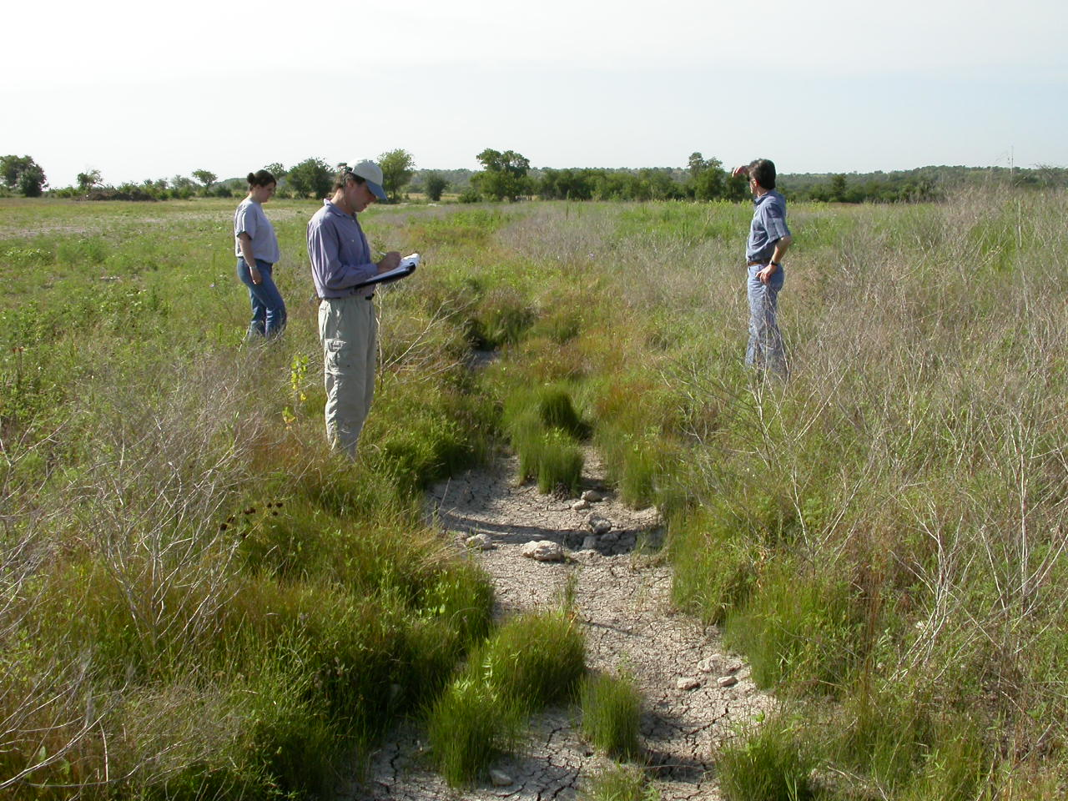
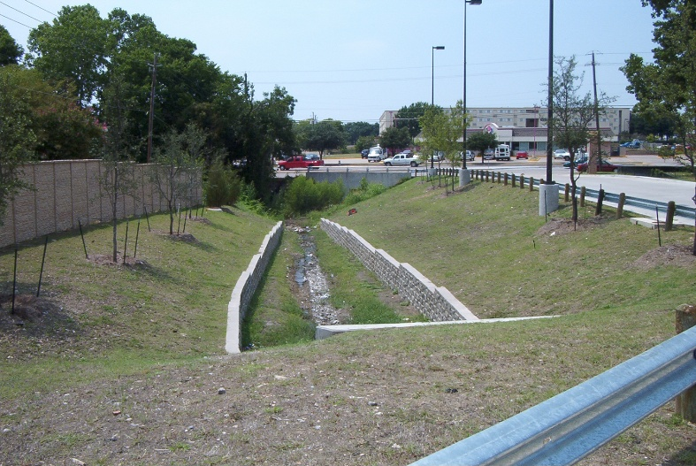
??????
Not obvious
Notes:
Upper photo same as photo on previous slide. If excavated in upland never was a water. If it has PER or INT flow, contributes water to JD water in typical year, AND is a relocated tributary, constructed in a trib, or is constructed in adjacent wetland then it is a WOTUS. Burden of proof lies w/ agencies to prove it is WOTUS

Slide 11
Approved & Preliminary Jurisdictional Determinations
Method to officially determine water feature is not jurisdictional is AJD
  Due to extensive ephemeral streams in SWF, AJD requests have spiked
PJD results in all water features on tract/parcel to be assumed potential waters of the US
Applications do not require AJD or PJD be submitted – only delineation
  Ensuring accuracy of impacts can be problematic & can delay permit evaluation

Slide 12
Severing Jurisdiction/Breaks
Proposed rule would have ended jurisdiction at first break (loss of waters)
  Final rule modified & Preamble includes full section on breaks of JD features
Rule allows non-JD features (e.g., ditch) to maintain connectivity of JD features others
Severing can occur of JD features
  Occurs when non-JD water feature or artificial structure does not convey flow once in typical year
  AJD must be elevated for higher level review
Notes:
Maintained a semi-significant nexus test for upstream JD features

Slide 13
Channelized Non-JD Surface Water
This type of feature includes non-jurisdictional ditches or ephemeral streams which are not themselves jurisdictional but can provide a channelized surface water connection for upstream perennial or intermittent waters once in a typical year.
Notes:
May need to look offsite from project area to determine jurisdiction. Sheet flow areas will sever JD areas. These need higher review on draft AJD calls.

Slide 14
Tributary
Tributary means a river, stream, or similar naturally occurring surface water channel that contributes surface water flow to a water identified in paragraph (a)(1) of this definition in a typical year either directly or through one or more waters identified in paragraph (a)(2)-(a)(4) of this definition. A tributary must be perennial or intermittent in a typical year.
  Perennial/intermittent flow continuously during certain times of year and MORE than in direct response to precipitation
  Ephemeral tributaries flow in DIRECT/IMMEDIATE response to precipitation

Slide 15
Adjacent Wetland
Adjacent wetland means wetlands that:
(i) abut, meaning to touch at least at one point or side of, a paragraph (a)(1) through (3) water;
(ii) are inundated by flooding from a paragraph (a)(1) through (3) water in a typical year;
(iii) are physically separated from a paragraph (a)(1) through (3) water only by a natural berm, bank, dune, or similar natural feature; or
(iv) are physically separated from a paragraph (a)(1) through (3) water only by an artificial dike, barrier, or similar artificial structure so long as that structure allows for a direct hydrologic surface connection between the wetlands and the paragraph (a)(1) through (3) water in a typical year, such as through a culvert, flood or tide gate, pump, or similar artificial feature. An adjacent wetland is jurisdictional in its entirety when a road or similar artificial structure divides the wetland, as long as the structure allows for a direct hydrologic surface connection through or over that structure in a typical year.
Notes:
Larger rivers

Slide 16
Typical Year
When precipitation & other climatic variables are within normal periodic range (e.g., seasonally, annually) for geographic area of applicable aquatic resource based on rolling 30-year period
  Provides a predictable framework to appropriately interpret data when determining the jurisdictional status of certain waterbodies.
  Applies to some of the requirements for the following categories of waters:
    (a)(2) -Tributaries;
    (a)(3) -Lakes and ponds, and impoundments of jurisdictional waters; and
    (a)(4) -Adjacent wetlands

Slide 17
Antecedent Precipitation Tool
Developed by the Corps.
Assesses rainfall data from preceding 30 years.
Automated & provides consistent methodology.
Includes information from the Web-based Water-Budget Interactive Modeling Program & Palmer Drought Severity Index.
Uses recommended parameters contained in NWPR’s preamble.
Merely a snapshot to assist in interpreting indicators/conditions

Slide 18
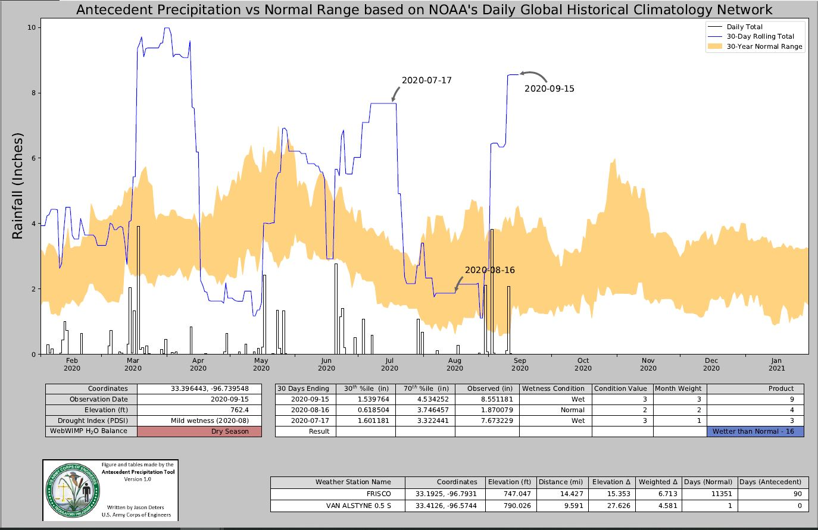
Antecedent Precipitation Tool

Slide 19
Application of Typical Year
In addition to the APT, should also consider:
  range of climatic variables
  data available through remote tools, and
  direct on-site observations.
Use professional judgment and a weight of evidence approach when considering precipitation normalcy along with other available data sources.
Notes:
A lot of room for inconsistency in amount of info needed as well as differing perspectives in a region and across the country

Slide 20
Application of Typical Year
May be applied to determine if a water or feature is not jurisdictional (e.g., ephemeral stream)
  Perennial/intermittent flow does not have to occur every year, only in a typical year, w/ some regularity
  A portion of adjacent wetland only has to flood during a typical year 1 time in the assessed period.
CAUTION: Application of typical year to determine adjacent wetland not the same as determining tributary flow status
Permanent, artificial hydrology sources can affect determination (e.g. wastewater)
Notes:
Moving water into and out of areas will be more of a consideration in our evaluations for jurisdiction – rather than just effects considerations if a permit is involved.

Slide 21
Stream Class (Eph/Int) Indicators
Streamflow duration assessments methods (SDAMs) referred to as tools to assist in determinations
  Not developed to reflect NWPR definitions
  No methods developed/calibrated for Texas
Multiple categories of indicators to consider
  Bank/channel hydric soils
  Hydrophytic vegetation in channel/banks
  Macro or micro-invertebrates & fish
  Algae
  Soil bacteria by-products indicating groundwater

Slide 22
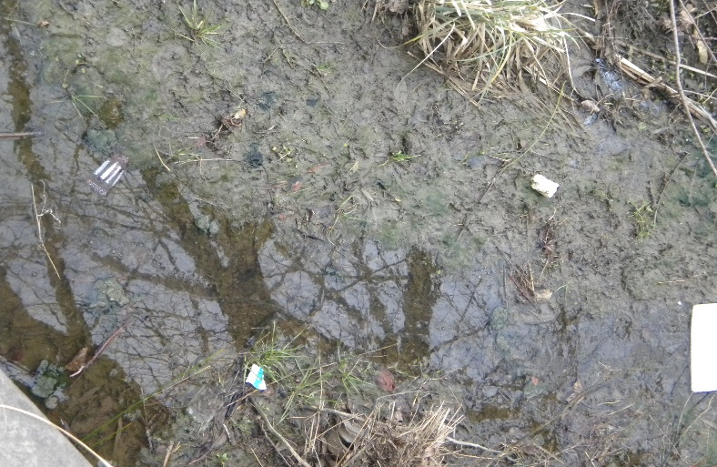
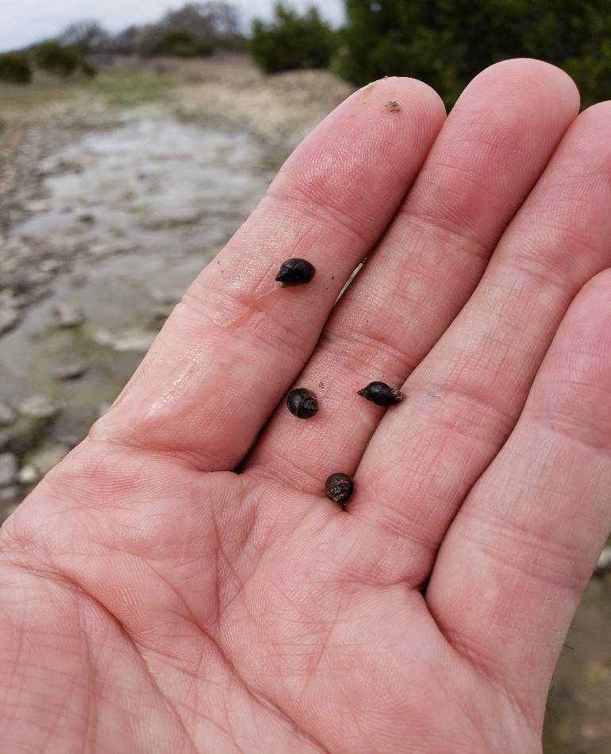
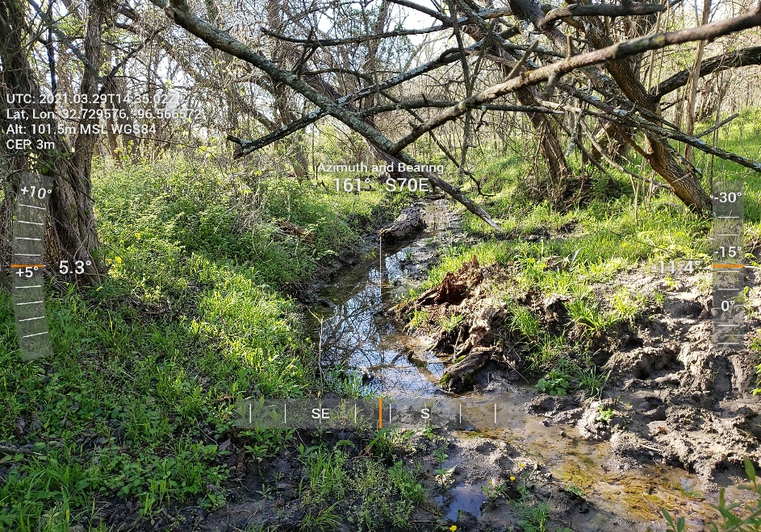
Stream Class (Eph/Int) Indicators

Slide 23
Effects of Rule in SWF
Have seen substantial reductions in area of jurisdiction (e.g. 60-100%)
Near elimination of PJDs w/ significant increase in AJDs
Substantial increase in effort/time required to conduct/verify delineations
Ongoing learning curves
Notes:
More time documenting/describing “water features” as well as presence of more tools to apply, more indicators to consider, changes in delineation documentation, greater opportunity for debate concerning which tools to use, how many indicators present/needed/revised, as well as outputs and results.

Slide 24
Corps Regulatory Program Information
National Regulatory Program Home Page:
http://www.usace.army.mil/Missions/CivilWorks/RegulatoryProgramand Permits.aspx
Fort Worth District Regulatory Home Page: https://www.swf.usace.army.mil/Missions/Regulatory
Fort Worth District (817) 886-1731 – Regulator of the Day
If this program assisted you, please help us improve our services by completing the survey on the following website: http://per2.nwp.usace.army.mil/survey.html

Slide 25
Questions?

